Slide 1



Slide 2
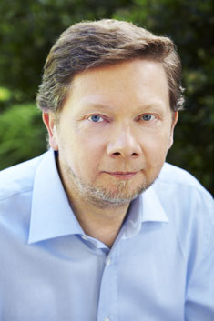
Biography
Spiritual Teacher and author was born in Germany and educated at the Universities of London and Cambridge.
At the age of twenty-nine a profound inner transformation radically changed the course of his life.
The next few years were devoted to understanding, integrating and deepening that transformation, which marked the beginning of an intense inward journey.

Slide 3

ENLIGHTENMENT
WHAT IS THAT?

Slide 4
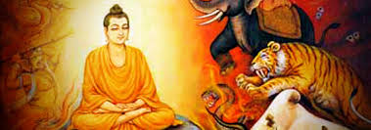
ENLIGHTENMENT IS THE END TO SUFFERING
GAUTAM BUDDHA

Slide 5

TO BE ENLIGHTENED IS TO BE CONNECTED TO YOUR TRUE NATURE BEYOND NAME AND FORM

Slide 6

THIS TRUE NATURE OR ONE’S BEING IS BEYOND LIFE AND DEATH .

Slide 7

THE GREATEST OBSTACLE TO EXPERIENCING THIS BEING IS…
IDENTIFICATION WITH YOUR MIND

Slide 8
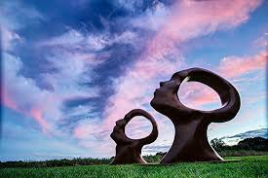
“VOICE IN YOUR HEAD” IS NOT WHO YOU ARE.
YOU ARE THE ONE WHO WITNESSES THE VOICE

Slide 9

THE BEGINNING OF FREEDOM IS THE REALIZATION THAT YOU ARE NOT THE THINKER
THE MOMENT YOU START WATCHING THE THINKER , YOU BEGIN TO AWAKEN

Slide 10
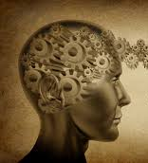
SO WHEN YOU LISTEN TO A THOUGHT, YOU ARE AWARE, NOT ONLY OF THE THOUGHT,BUT ALSO OF YOURSELF AS THE THINKER

Slide 11

AS YOU LISTEN TO THE THOUGHT, YOU FEEL A CONSCIOUS PRESENCE…….
YOUR DEEPER SELF…..
BEHIND THE THOUGHT

Slide 12

THE THOUGHT THEN LOSES its POWER OVER YOU AND QUICKLY SUBSIDES……THE NO MIND STATE

Slide 13

YOU WILL FEEL A SUBTLE ENAMATION OF JOY ARISING FROM DEEP WITHIN…… THE JOY OF BEING

Slide 14

SO ENLIGHTENMENT IS
RISING ABOVE THOUGHT

